Slide 1



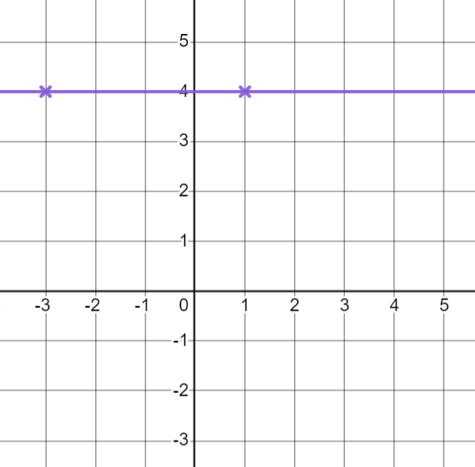
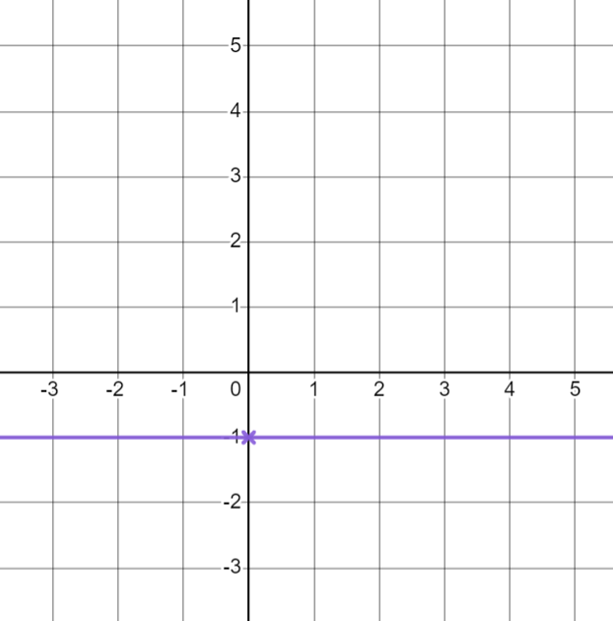
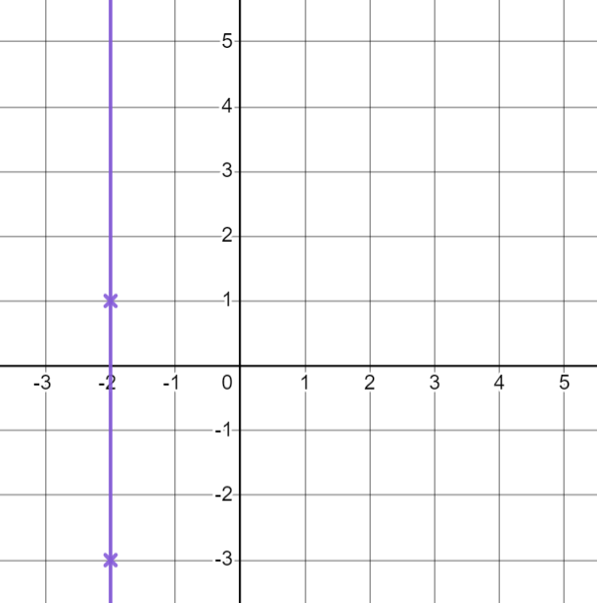



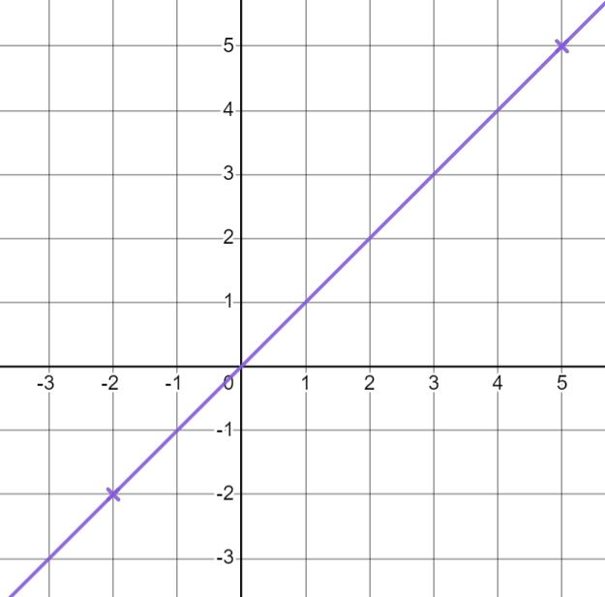
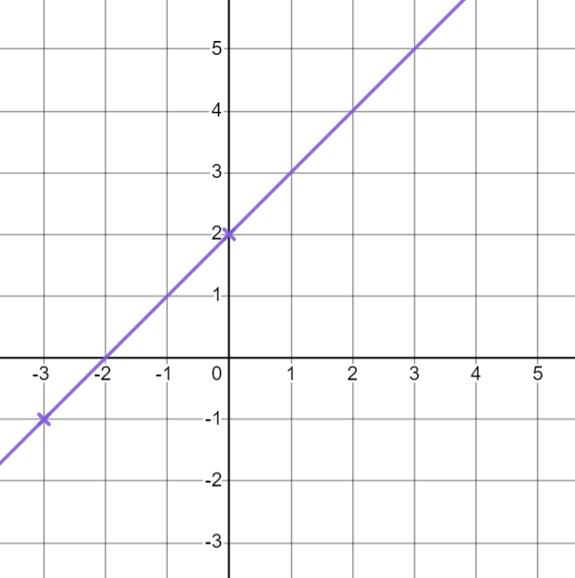
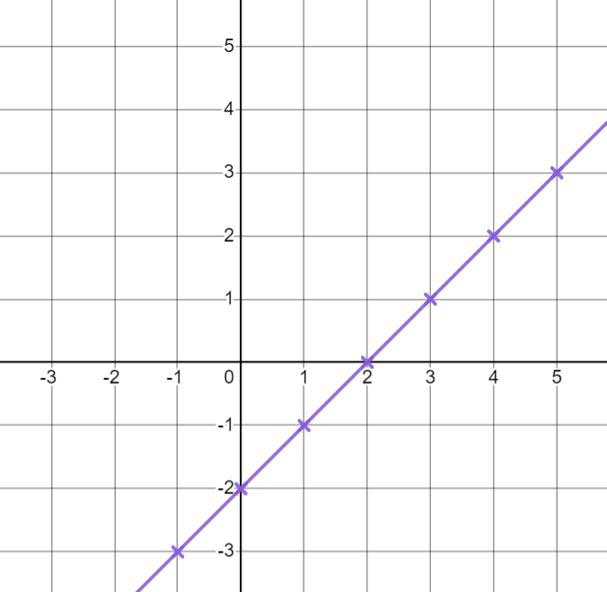


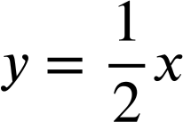
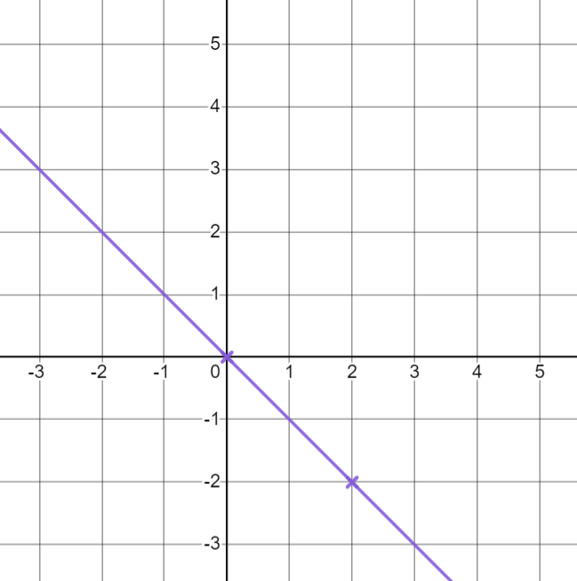
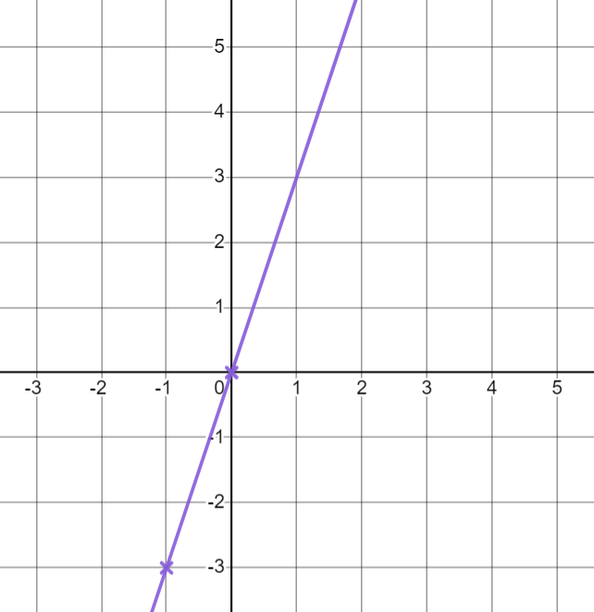
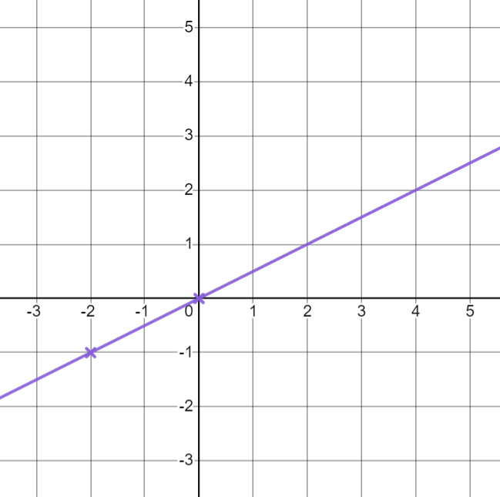
Plotting a relationship
Task A: Plotting lines from coordinates
For each rule, fill in the coordinates. Use them to draw the line for that rule.
a)
E.g.
(3,4)
b)
E.g.
(4,-1)
c)
E.g.
(-2,4)
(1, 4 ) (-3, 4 )
(0,-1) (?,-1)
(-2 ,-3) (-2 ,1)
d)
E.g.
(1,1)
e)
E.g.
(3,5)
f)
(-2,-2 ) ( 5 ,5)
(-3, -1 ) ( 0 ,2)
E.g.(-1,-3) (0,-2) (1,-1) (2,0) (3,1) (4,2) (5,3)
g)
E.g.
(-3,3)
h)
E.g.
(-1,-3) (1,3)
i)
E.g.
(4,2)
(2,-2 ) ( 0 ,0)
(0, 0 )
(0, 0 ) (-2 ,-1)

Slide 2






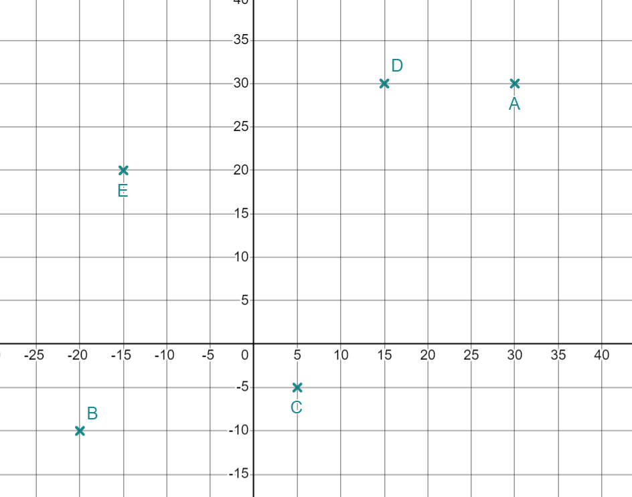




Plotting a relationship
Task B: Identifying whether points are on a line
For each equation, does the coordinate lie on the given line?
Give a reason for your answer.
(4,18)
(6,-12)
(0,0)
(25,22.5)
(11,37)
(10, 50)
No 4 × 5 ≠ 18
Yes 6 × -2 = -12
Yes 0 × 3.5 = 0
No 25 - 5.5 ≠ 22.5
Yes 11 × 3 + 4 = 37
No 10 × 5 - 8 ≠ 50
2) Alex has started to plot some lines.
He has plotted one point from each line but cannot remember which point goes with which line.
Match the points with the equation for the line Alex has tried to plot.
a)
b)
c)
d)
e)
E (-15,20)
A (30,30)
D (15,30)
C (5,-5)
B (-20,-10)
Mathematics in Education and Industry
v2.2

